Slide 1

Signal and information (SigInf)
204.1
Dr. Robin Delabays and Dre. Benedetta Franceschiello
14.04.2025
benedetta.franceschiello@hevs.ch
Robin.delabays.hevs.ch

Slide 2
Lesson 8. Image processing
Dr. Robin Delabays and Dre. Benedetta Franceschiello
03.03.2025
benedetta.franceschiello@hevs.ch
Robin.delabays.hevs.ch

Slide 3
1. Introduction to images

Slide 4
An image is a 2D signal
An image is a 2D grid of pixel values, each representing light intensity. Greyscale images are single-channel arrays and color images are three-channel (RGB) arrays.
Definition
Notes:
Slide Introduction:
“In today’s class, we’re diving into the world of image processing, specifically focusing on analyzing 2D images. Building on our previous discussions in statistical signal processing, we’ll leverage those foundations to understand and manipulate images as 2D signals.”
Key Points to Mention:
Connecting Signal and Image Processing:
Emphasize that an image can be thought of as a 2D signal.
Similar to how we analyzed temporal signals, we’ll examine spatial data, where each pixel represents a signal intensity in a 2D grid.
Noise Concepts:
Recall different noise types from signal processing (e.g., Gaussian noise) and explain that images also contain noise, which impacts their clarity and accuracy.
Mention that the filtering techniques used in statistical signal processing are directly applicable to image noise reduction, but with adjustments for 2D structures.
Frequency Domain Analysis:
Highlight that we’ll use the Fourier transform in a 2D context to analyze and filter images, much like frequency-based filtering in signal processing.
Explain that low and high-frequency content in images serves similar roles to those in signals, with high frequencies representing edges and fine details, and low frequencies representing smooth regions.
Detection and Segmentation:
Connect anomaly or change detection in signals to edge detection in images, where we look for sudden changes in pixel intensities.
Segmentation in images, like identifying regions of interest, can be compared to finding significant segments in a time series or frequency range.
Slide Visual Suggestion:
Add a simple illustration showing an image as a 2D matrix of pixel intensities, with a title like "Images as 2D Signals."
Include a small side-by-side comparison: one side shows a 1D signal with its frequency spectrum, while the other shows an image with its 2D frequency transform (if you have access to example visuals).

Slide 5
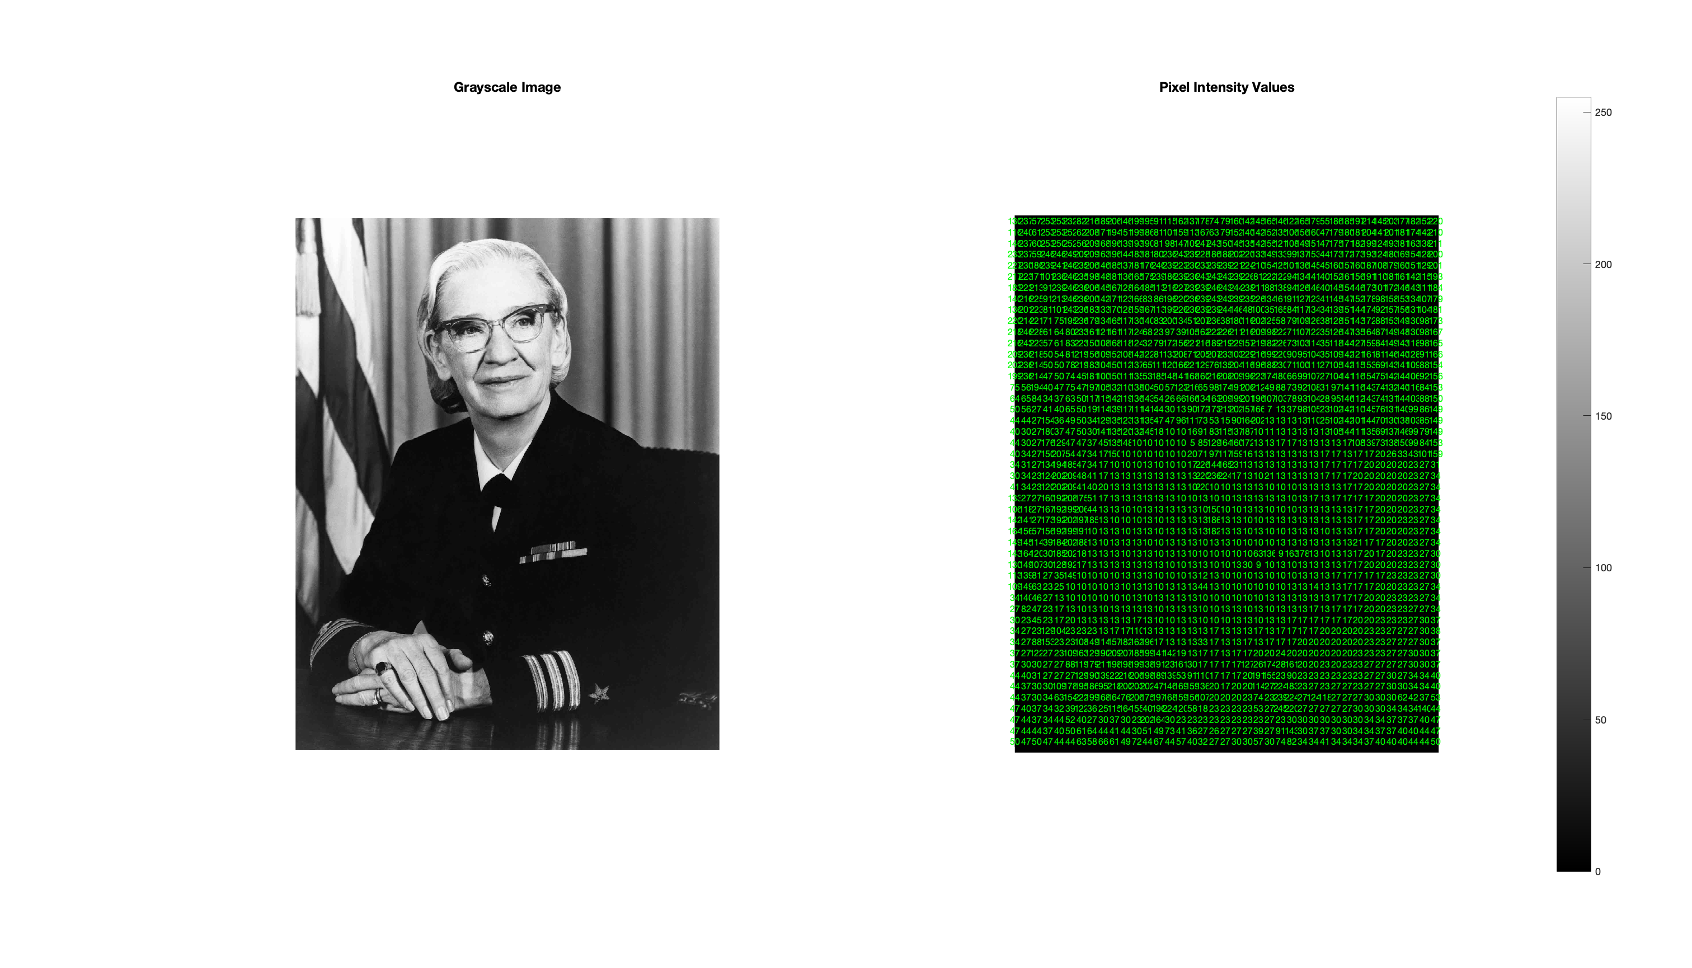
An image is a 2D signal: greyscale
Notes:
Slide Introduction:
“In today’s class, we’re diving into the world of image processing, specifically focusing on analyzing 2D images. Building on our previous discussions in statistical signal processing, we’ll leverage those foundations to understand and manipulate images as 2D signals.”
Key Points to Mention:
Connecting Signal and Image Processing:
Emphasize that an image can be thought of as a 2D signal.
Similar to how we analyzed temporal signals, we’ll examine spatial data, where each pixel represents a signal intensity in a 2D grid.
Noise Concepts:
Recall different noise types from signal processing (e.g., Gaussian noise) and explain that images also contain noise, which impacts their clarity and accuracy.
Mention that the filtering techniques used in statistical signal processing are directly applicable to image noise reduction, but with adjustments for 2D structures.
Frequency Domain Analysis:
Highlight that we’ll use the Fourier transform in a 2D context to analyze and filter images, much like frequency-based filtering in signal processing.
Explain that low and high-frequency content in images serves similar roles to those in signals, with high frequencies representing edges and fine details, and low frequencies representing smooth regions.
Detection and Segmentation:
Connect anomaly or change detection in signals to edge detection in images, where we look for sudden changes in pixel intensities.
Segmentation in images, like identifying regions of interest, can be compared to finding significant segments in a time series or frequency range.
Slide Visual Suggestion:
Add a simple illustration showing an image as a 2D matrix of pixel intensities, with a title like "Images as 2D Signals."
Include a small side-by-side comparison: one side shows a 1D signal with its frequency spectrum, while the other shows an image with its 2D frequency transform (if you have access to example visuals).

Slide 6
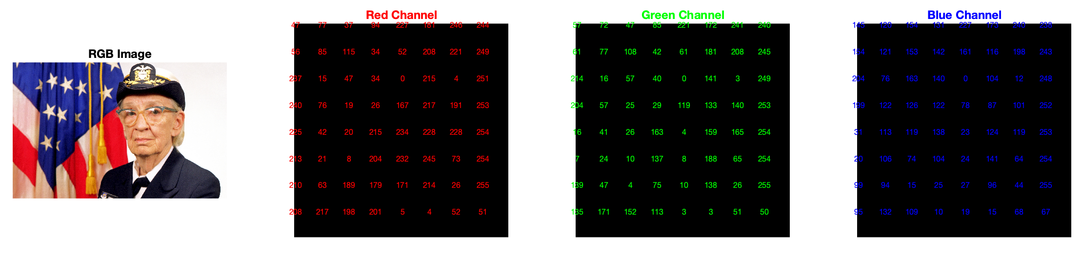
An image is a 2D signal: RGB image
Notes:
Slide Introduction:
“In today’s class, we’re diving into the world of image processing, specifically focusing on analyzing 2D images. Building on our previous discussions in statistical signal processing, we’ll leverage those foundations to understand and manipulate images as 2D signals.”
Key Points to Mention:
Connecting Signal and Image Processing:
Emphasize that an image can be thought of as a 2D signal.
Similar to how we analyzed temporal signals, we’ll examine spatial data, where each pixel represents a signal intensity in a 2D grid.
Noise Concepts:
Recall different noise types from signal processing (e.g., Gaussian noise) and explain that images also contain noise, which impacts their clarity and accuracy.
Mention that the filtering techniques used in statistical signal processing are directly applicable to image noise reduction, but with adjustments for 2D structures.
Frequency Domain Analysis:
Highlight that we’ll use the Fourier transform in a 2D context to analyze and filter images, much like frequency-based filtering in signal processing.
Explain that low and high-frequency content in images serves similar roles to those in signals, with high frequencies representing edges and fine details, and low frequencies representing smooth regions.
Detection and Segmentation:
Connect anomaly or change detection in signals to edge detection in images, where we look for sudden changes in pixel intensities.
Segmentation in images, like identifying regions of interest, can be compared to finding significant segments in a time series or frequency range.
Slide Visual Suggestion:
Add a simple illustration showing an image as a 2D matrix of pixel intensities, with a title like "Images as 2D Signals."
Include a small side-by-side comparison: one side shows a 1D signal with its frequency spectrum, while the other shows an image with its 2D frequency transform (if you have access to example visuals).

Slide 7
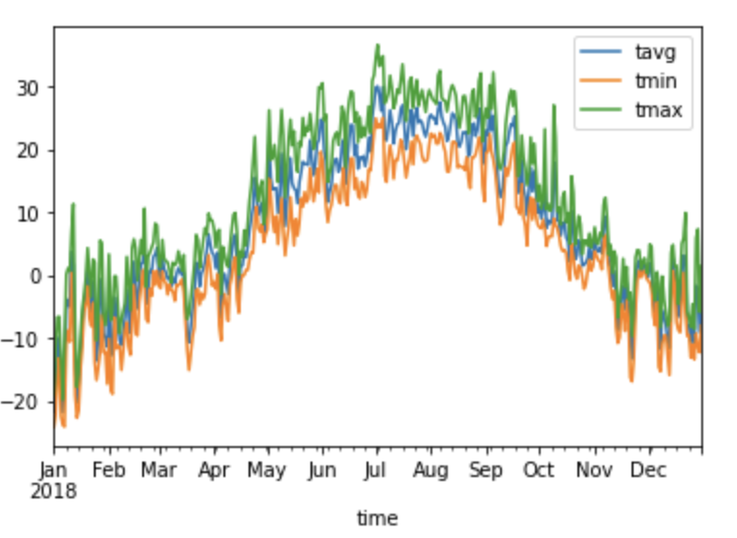
An image is a 2D signal
x
y
x
(where here your x is time)
We investigate spatial relationships between pixels
Notes:
Slide Introduction:
“In today’s class, we’re diving into the world of image processing, specifically focusing on analyzing 2D images. Building on our previous discussions in statistical signal processing, we’ll leverage those foundations to understand and manipulate images as 2D signals.”
Key Points to Mention:
Connecting Signal and Image Processing:
Emphasize that an image can be thought of as a 2D signal.
Similar to how we analyzed temporal signals, we’ll examine spatial data, where each pixel represents a signal intensity in a 2D grid.
Noise Concepts:
Recall different noise types from signal processing (e.g., Gaussian noise) and explain that images also contain noise, which impacts their clarity and accuracy.
Mention that the filtering techniques used in statistical signal processing are directly applicable to image noise reduction, but with adjustments for 2D structures.
Frequency Domain Analysis:
Highlight that we’ll use the Fourier transform in a 2D context to analyze and filter images, much like frequency-based filtering in signal processing.
Explain that low and high-frequency content in images serves similar roles to those in signals, with high frequencies representing edges and fine details, and low frequencies representing smooth regions.
Detection and Segmentation:
Connect anomaly or change detection in signals to edge detection in images, where we look for sudden changes in pixel intensities.
Segmentation in images, like identifying regions of interest, can be compared to finding significant segments in a time series or frequency range.
Slide Visual Suggestion:
Add a simple illustration showing an image as a 2D matrix of pixel intensities, with a title like "Images as 2D Signals."
Include a small side-by-side comparison: one side shows a 1D signal with its frequency spectrum, while the other shows an image with its 2D frequency transform (if you have access to example visuals).

Slide 8
2. NOISE

Slide 9
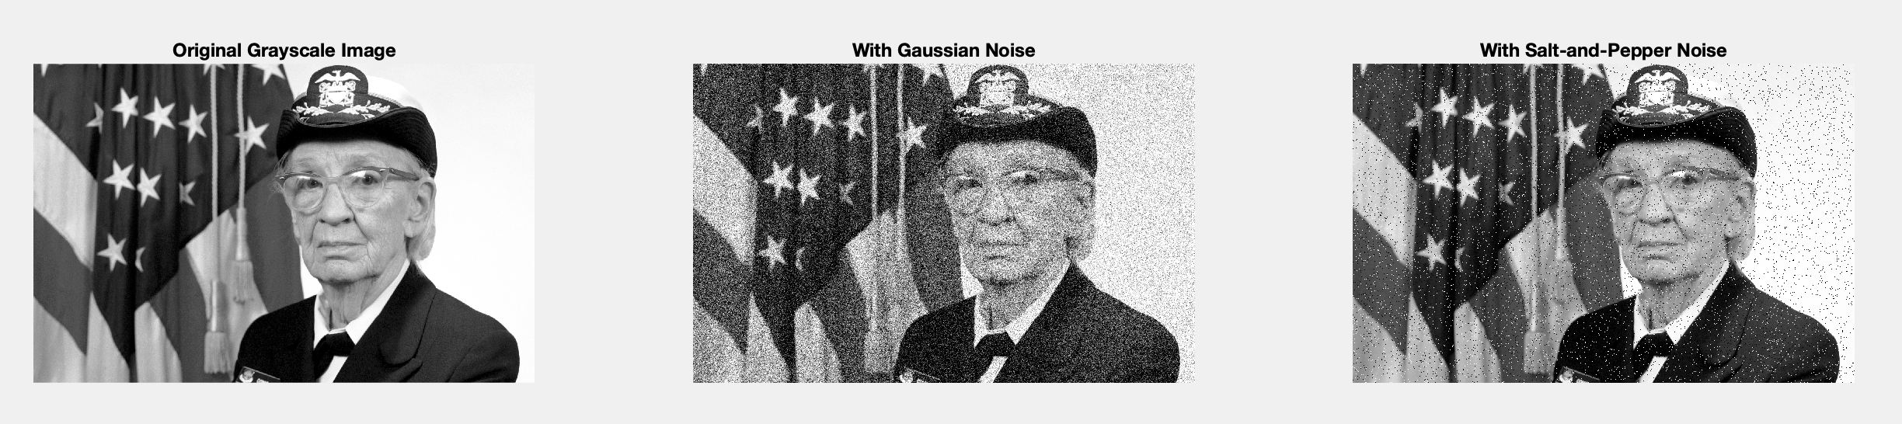
Noise in an image
Noise: as for 1D signal, noise is a variation that perturbs the signal clarity (or message that the image conveys), so it makes the interpretation harder.
Filtering: clean the noise.
Notes:
Noise Concepts:
Recall different noise types from signal processing (e.g., Gaussian noise) and explain that images also contain noise, which impacts their clarity and accuracy.
Mention that the filtering techniques used in statistical signal processing are directly applicable to image noise reduction, but with adjustments for 2D structures.
Noise in Images:
Discuss common types of noise in images: Gaussian noise (small random variations) and salt-and-pepper noise (isolated white/black pixels).
Link to Statistical Signal Processing:
“Noise in images affects visual clarity, just like noise in time-series data affects signal interpretation. We’ll use similar filtering techniques to reduce this noise.”
Example Image:
Show an image with Gaussian noise, followed by the same image with salt-and-pepper noise for comparison.
Visual Suggestion:
Examples of each noise type on the same image for easy comparison.

Slide 10
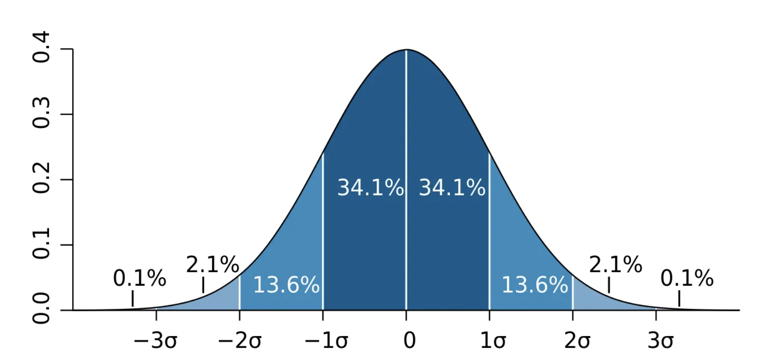
Gaussian Noise in an image
Noise: to all pixel values, random noise sample from a Gaussian distribution is added – so that it appears as random (but smooth) variations across the image.
https://wiki.cloudfactory.com/docs/mp-wiki/augmentations/gaussian-noise
Notes:
%% Description of Noise Types
fprintf('\n### Noise Types ###\n');
fprintf('1. Gaussian Noise:\n');
fprintf(' - Gaussian noise is characterized by a normal (Gaussian) distribution.\n');
fprintf(' - It affects all pixel values by adding random noise sampled from a Gaussian distribution.\n');
fprintf(' - Typically appears as a random smooth variation across the image.\n');
fprintf(' - Common in real-world scenarios like thermal noise in sensors or electronic noise in cameras.\n\n');
Explain you can manipulate mean and std of the distribution to produce different type of noise.

Slide 11
Salt and Pepper Noise in an image
Noise: randomly changes some pixels to either the maximum intensity (salt) or the minimum intensity (pepper) – this is caused by data transmission errors, for example.
Notes:
fprintf('2. Salt-and-Pepper Noise:\n');
fprintf(' - Salt-and-Pepper noise randomly changes some pixels to either the maximum intensity (salt) or the minimum intensity (pepper).\n');
fprintf(' - Appears as random white (salt) and black (pepper) dots on the image.\n');
fprintf(' - Often caused by data transmission errors or dust/scratches on film.\n');

Slide 12
3. Filtering in the spatial domain

Slide 13
Image preprocessing techniques in the spatial domain
Filtering: we apply filtering to manipulate pixel values in an image, in order to make certain features appearing, such as edges, or to erase noise.
Notes:
Slide 5: Image Preprocessing Techniques
Title: Image Preprocessing Techniques
Enhancement:
Introduce histogram equalization (improving contrast by spreading out intensity levels) and contrast adjustment.
Noise Reduction:
Explain median and Gaussian filters, linking to similar time-series noise reduction techniques.
Visual Comparisons:
Show a noisy image before and after applying median and Gaussian filters.
Visual Suggestion:
Before-and-after images showing the impact of each technique.

Slide 14
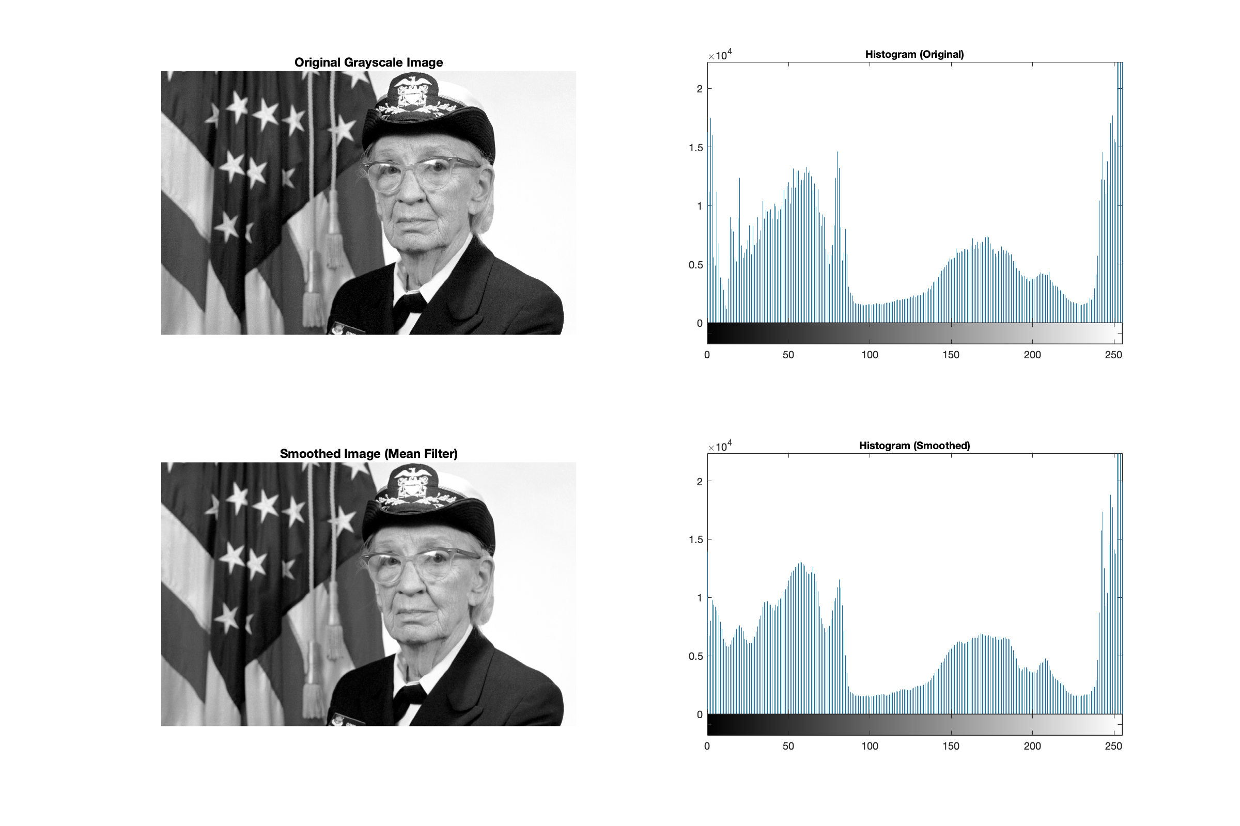
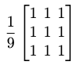
Smoothing filtering (low-pass filtering): mean filtering
Smoothing: Smoothing reduces noise and removes sharp intensity variations by averaging pixel intensities.
Mean filtering:
Replaces each pixel with the average of its neighbourhood.
Kernel Example:
Use Case: Reduces Gaussian noise but blurs edges.
Notes:
Slide 5: Image Preprocessing Techniques
Title: Image Preprocessing Techniques
Enhancement:
Introduce histogram equalization (improving contrast by spreading out intensity levels) and contrast adjustment.
Noise Reduction:
Explain median and Gaussian filters, linking to similar time-series noise reduction techniques.
Visual Comparisons:
Show a noisy image before and after applying median and Gaussian filters.
Visual Suggestion:
Before-and-after images showing the impact of each technique.

Slide 15
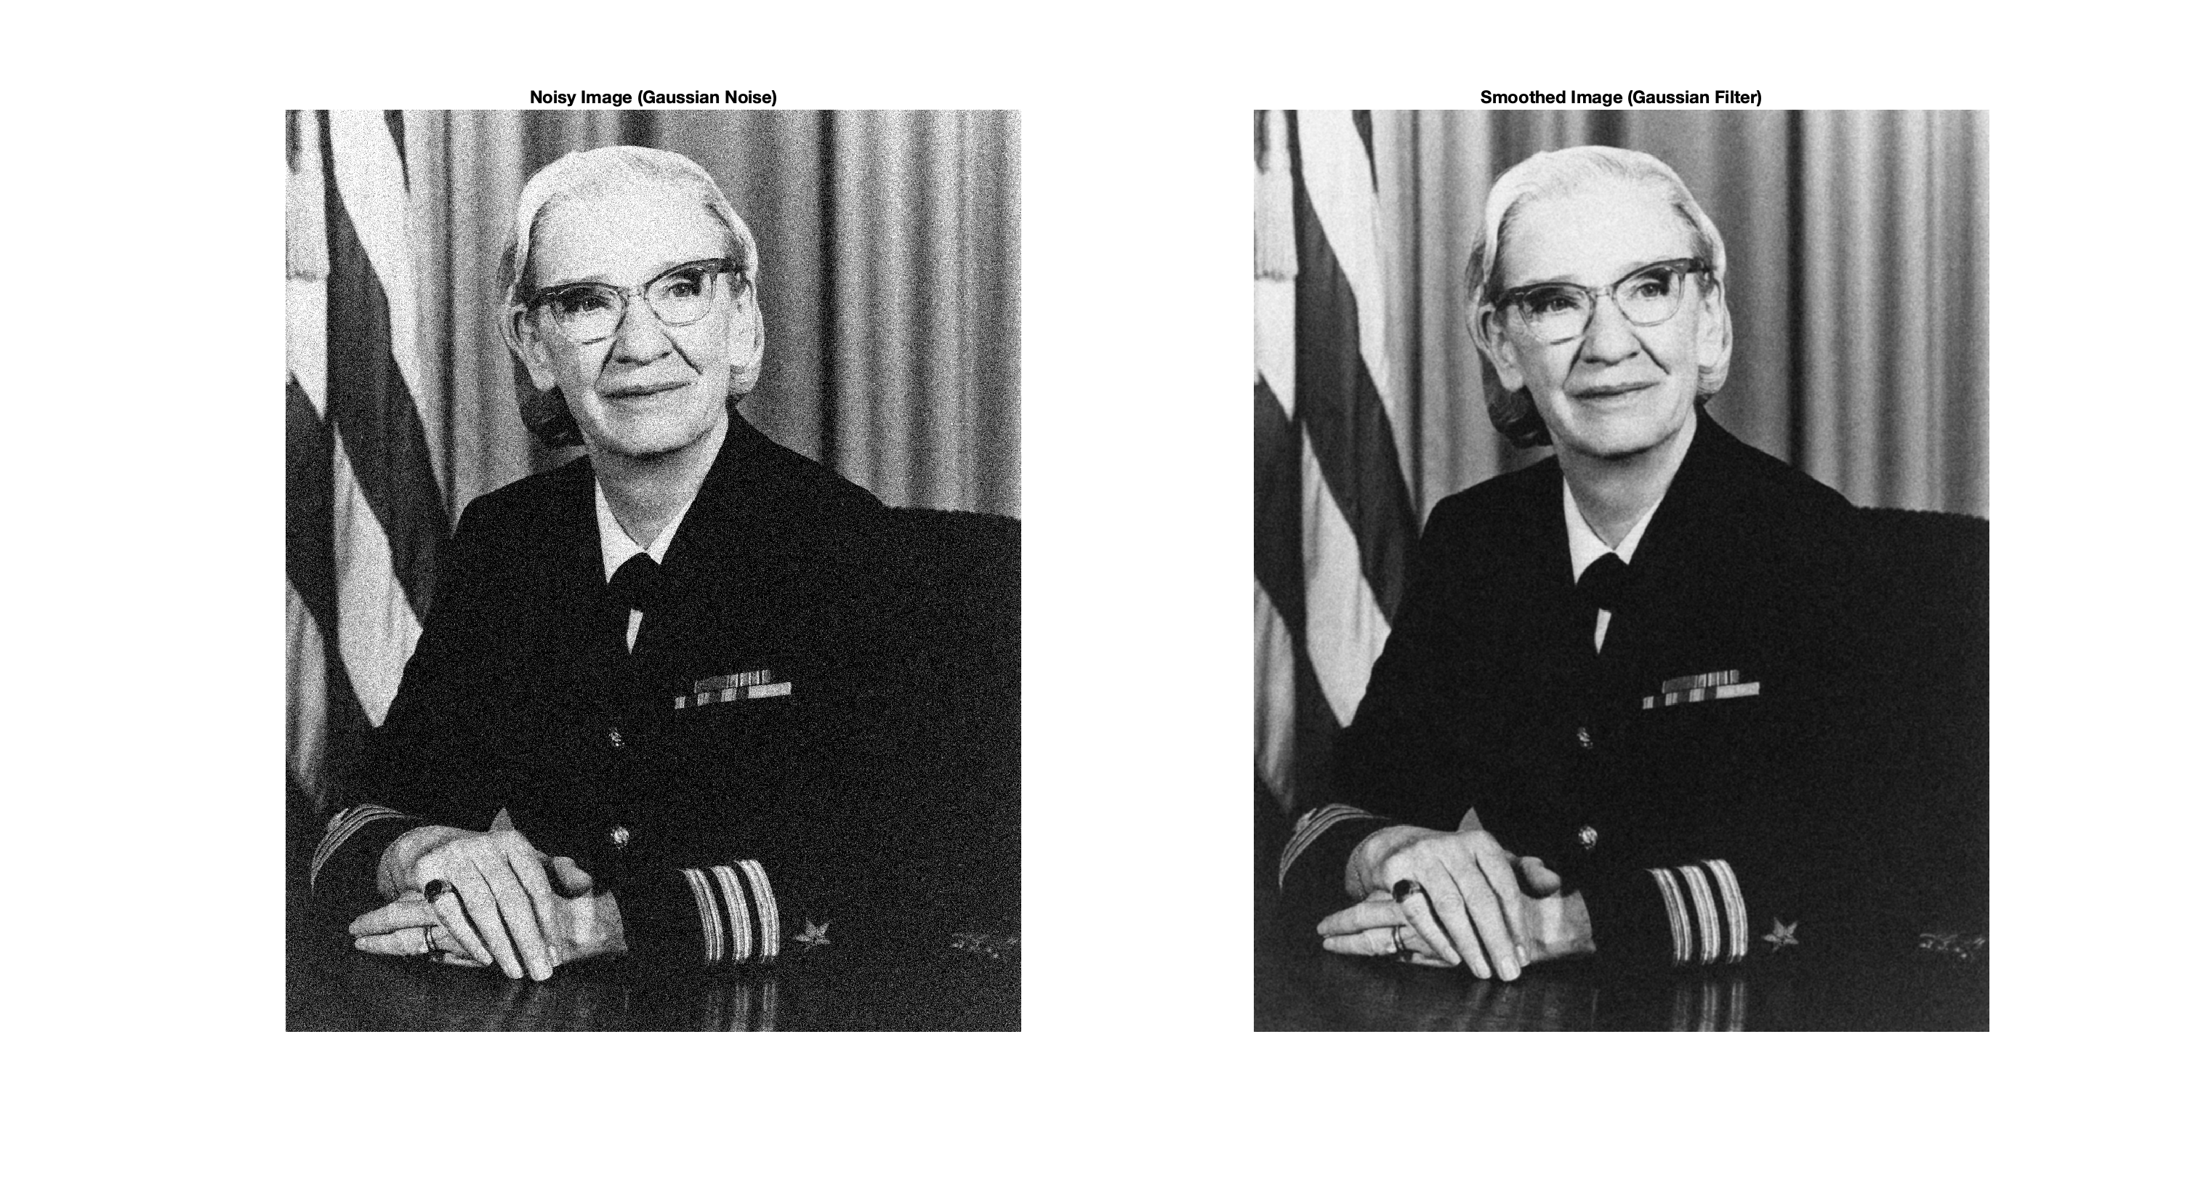
Smoothing filtering (low-pass filtering): Gaussian filtering. It is also a noise reduction filtering
Smoothing: Smoothing reduces noise and removes sharp intensity variations by averaging pixel intensities.
Gaussian filtering:
Uses a Gaussian-shaped kernel for weighted averaging, preserving edges better than the mean filter
Use Case: Preserves edges and can also remove the noise.
Notes:
Slide 5: Image Preprocessing Techniques
Title: Image Preprocessing Techniques
Enhancement:
Introduce histogram equalization (improving contrast by spreading out intensity levels) and contrast adjustment.
Noise Reduction:
Explain median and Gaussian filters, linking to similar time-series noise reduction techniques.
Visual Comparisons:
Show a noisy image before and after applying median and Gaussian filters.
Visual Suggestion:
Before-and-after images showing the impact of each technique.

Slide 16
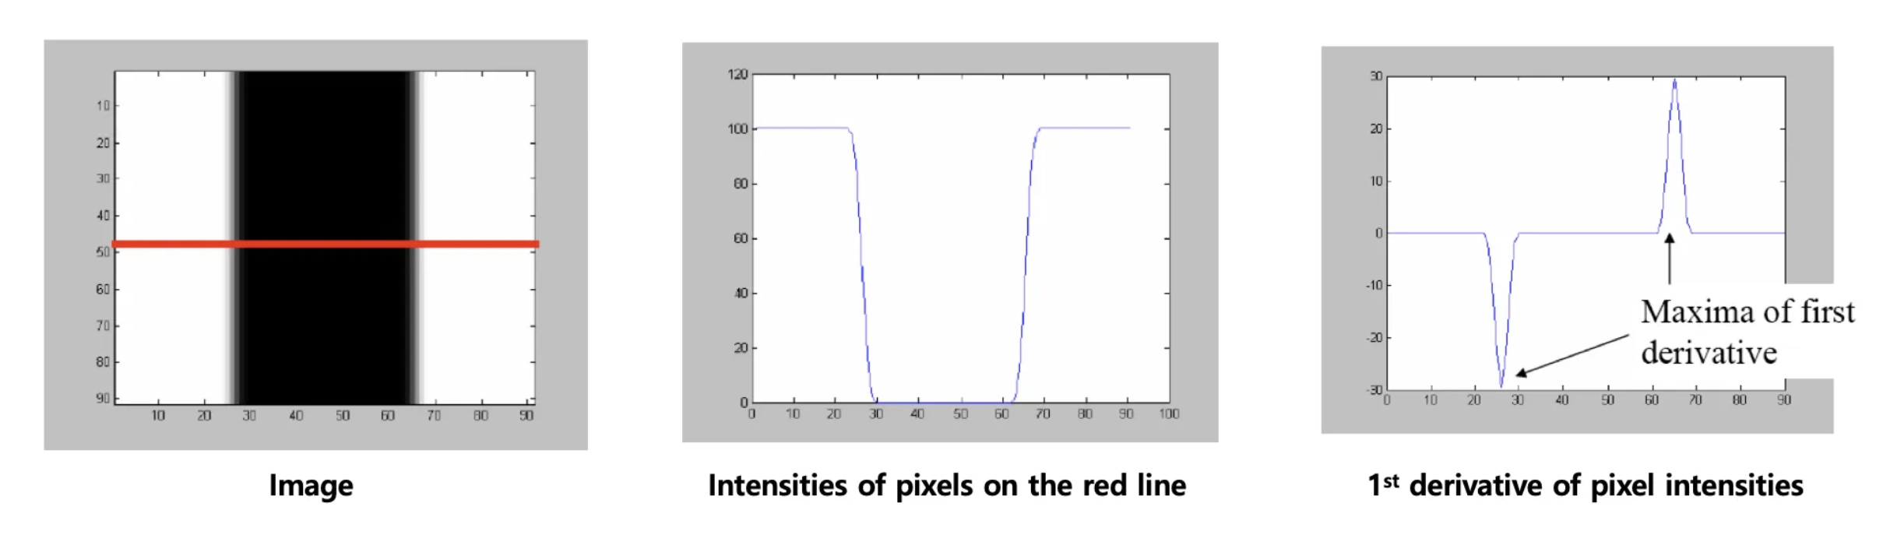
Sharpening filtering (high-pass filtering): Gradient
Sharpening filters (gradient): detect edges by computing intensity gradients along image (x,y) direction (or a combination of both).
Used for Edges detection (or features detection)
https://medium.com/jun94-devpblog/cv-3-gradient-and-laplacian-filter-difference-of-gaussians-dog-7c22e4a9d6cc
Notes:
Slide 5: Image Preprocessing Techniques
Title: Image Preprocessing Techniques
Enhancement:
Introduce histogram equalization (improving contrast by spreading out intensity levels) and contrast adjustment.
Noise Reduction:
Explain median and Gaussian filters, linking to similar time-series noise reduction techniques.
Visual Comparisons:
Show a noisy image before and after applying median and Gaussian filters.
Visual Suggestion:
Before-and-after images showing the impact of each technique.

Slide 17
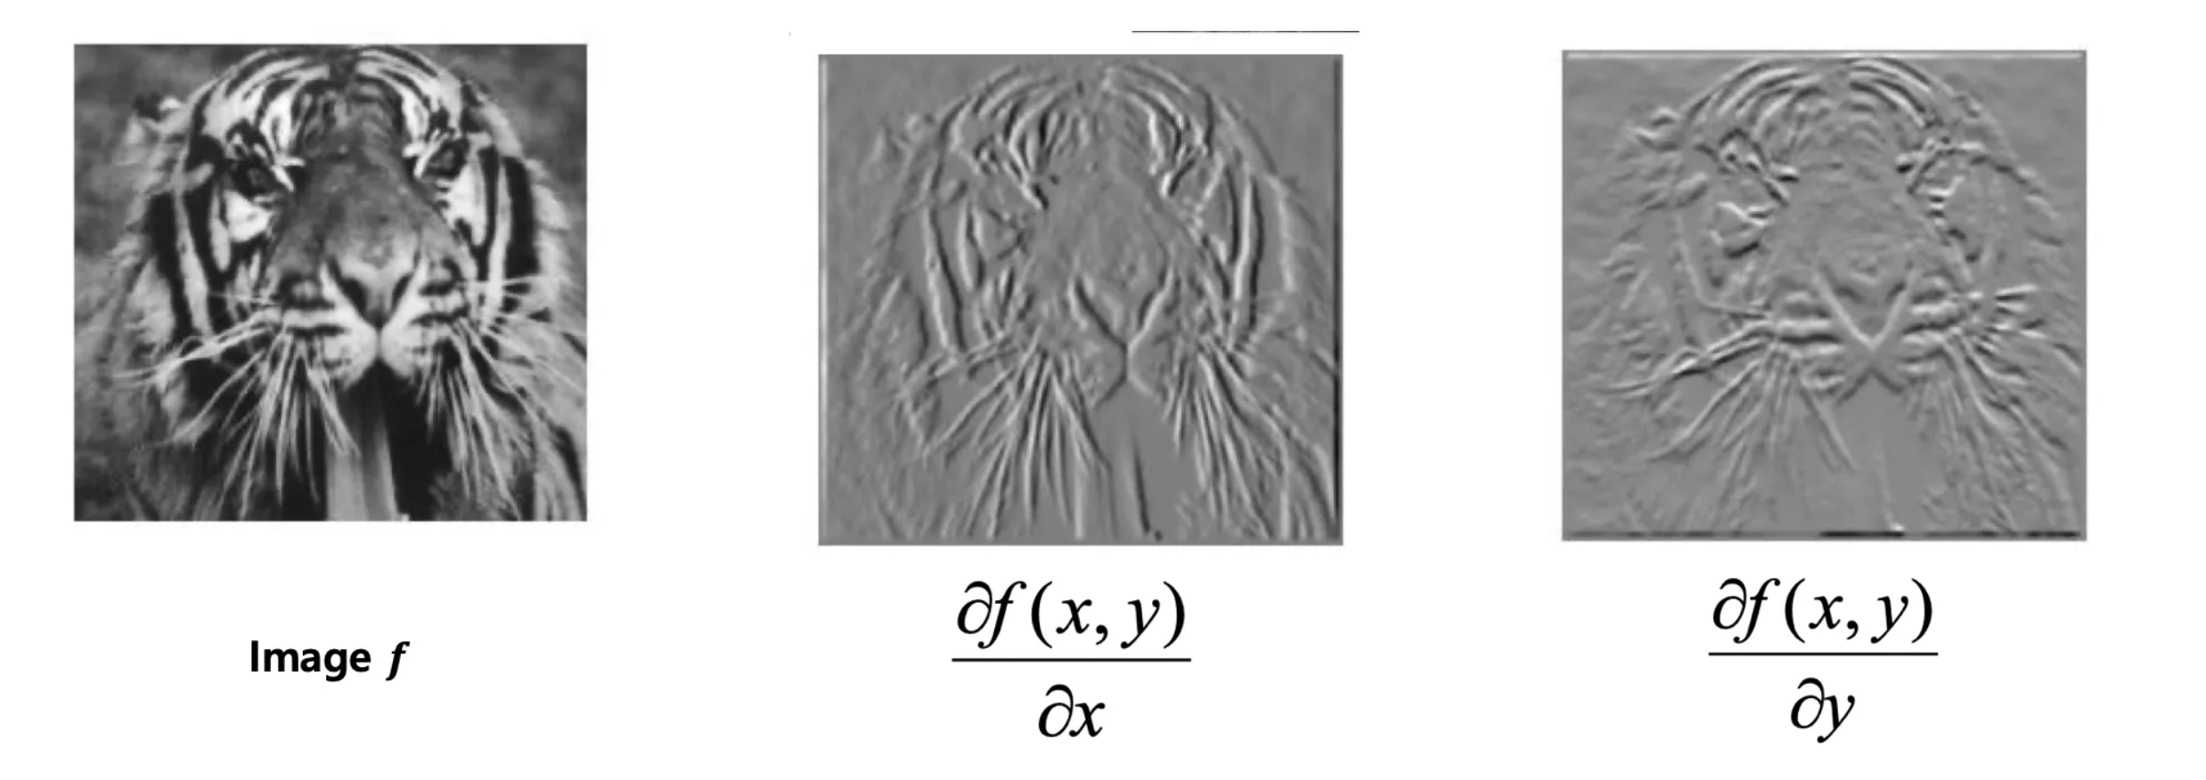
Sharpening filtering (high-pass filtering): Gradient
Sharpening filters (gradient): detect edges by computing intensity gradients along image (x,y) direction (or a combination of both).
Used for Edges detection (or features detection)
Notes:
Slide 5: Image Preprocessing Techniques
Title: Image Preprocessing Techniques
Enhancement:
Introduce histogram equalization (improving contrast by spreading out intensity levels) and contrast adjustment.
Noise Reduction:
Explain median and Gaussian filters, linking to similar time-series noise reduction techniques.
Visual Comparisons:
Show a noisy image before and after applying median and Gaussian filters.
Visual Suggestion:
Before-and-after images showing the impact of each technique.

Slide 18
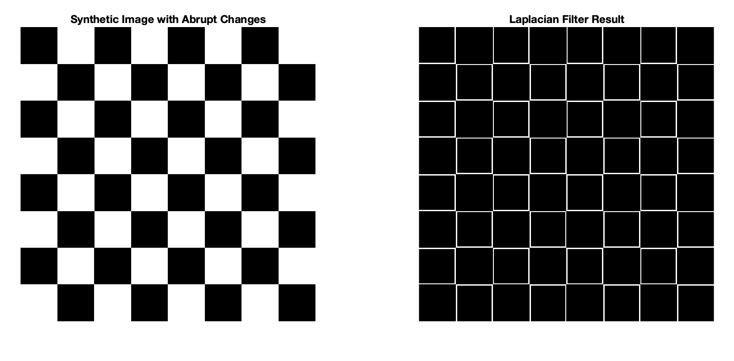
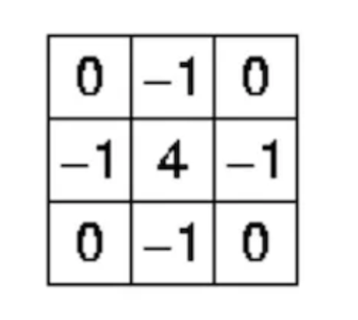
Sharpening filtering (high-pass filtering): Laplacian
Sharpening filters (Laplacian): another edge detector, it highlights regions where pixels intensity dramatically change.
Matrix kernel:
Notes:
Slide 5: Image Preprocessing Techniques
Title: Image Preprocessing Techniques
Enhancement:
Introduce histogram equalization (improving contrast by spreading out intensity levels) and contrast adjustment.
Noise Reduction:
Explain median and Gaussian filters, linking to similar time-series noise reduction techniques.
Visual Comparisons:
Show a noisy image before and after applying median and Gaussian filters.
Visual Suggestion:
Before-and-after images showing the impact of each technique.

Slide 19
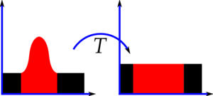
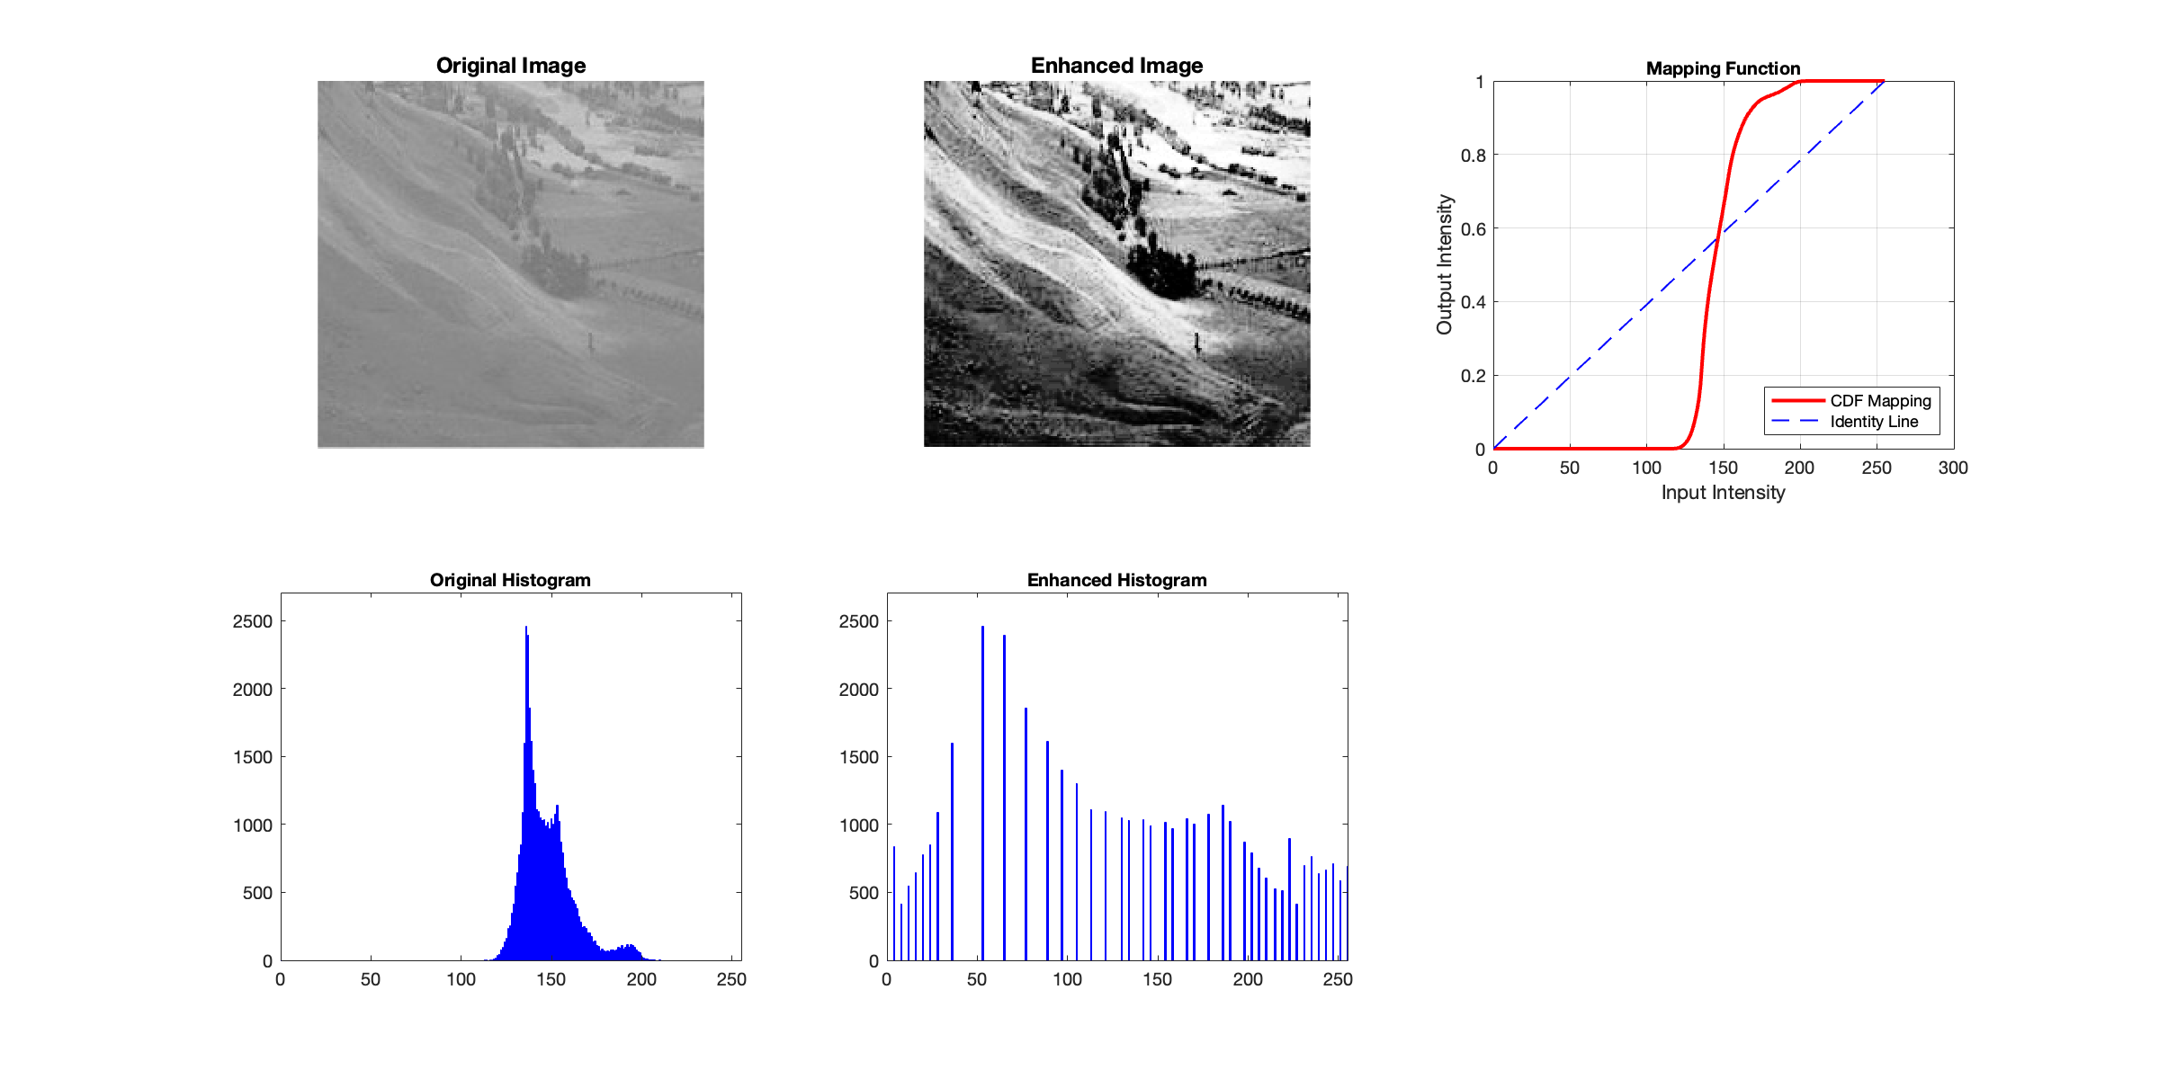
Contrast enhancement via histogram equalization
Enhancement: we redistribute the pixel intensity over the entire available range. To do so, we map the comulative distribution of the intensity values to a linear distribution. This enhances (increase the contrast) of the image.
https://docs.opencv.org/4.x/d5/daf/tutorial_py_histogram_equalization.html
Notes:
Slide 5: Image Preprocessing Techniques
Title: Image Preprocessing Techniques
Enhancement:
Introduce histogram equalization (improving contrast by spreading out intensity levels) and contrast adjustment.
Noise Reduction:
Explain median and Gaussian filters, linking to similar time-series noise reduction techniques.
Visual Comparisons:
Show a noisy image before and after applying median and Gaussian filters.
Visual Suggestion:
Before-and-after images showing the impact of each technique.

Slide 20
Image preprocessing techniques: enhancement
Enhancement: we redistribute the pixel intensity over the entire available range. To do so, we map the comulative distribution of the intensity values to a linear distribution. This enhances (increase the contrast) of the image.
https://docs.opencv.org/4.x/d5/daf/tutorial_py_histogram_equalization.html
Notes:
Slide 5: Image Preprocessing Techniques
Title: Image Preprocessing Techniques
Enhancement:
Introduce histogram equalization (improving contrast by spreading out intensity levels) and contrast adjustment.
Noise Reduction:
Explain median and Gaussian filters, linking to similar time-series noise reduction techniques.
Visual Comparisons:
Show a noisy image before and after applying median and Gaussian filters.
Visual Suggestion:
Before-and-after images showing the impact of each technique.

Slide 21
4. Filtering in the frequency domain
Notes:
Basics of Frequency Domain Filtering
In the frequency domain, an image is represented by its spatial frequency components:
Low frequencies: Represent smooth areas or overall illumination (large-scale structures).
High frequencies: Represent rapid intensity changes, such as edges and fine details.
Filtering Process:
Perform a 2D Fourier Transform to convert the image from the spatial domain to the frequency domain.
Modify the frequency components using a filter.
Perform an Inverse Fourier Transform to return to the spatial domain.

Slide 22
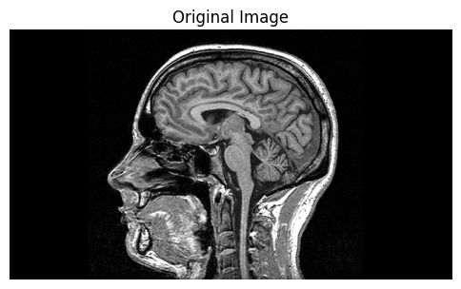
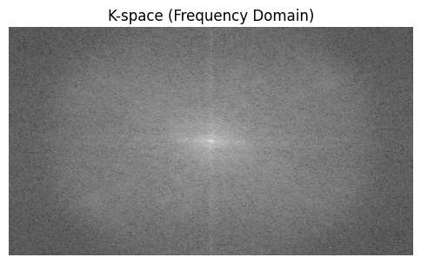

Frequency domain analysis: recap FT on images
Low frequencies: responsible for the slowly changing patterns, such as the average values and smooth transitions.
Higher (increasing) frequencies: sharp changes (edges)
Go back on the DFT tutorial from Mauro!
Notes:
Slide 6: Frequency Domain in Image Processing
Title: Frequency Domain in Image Processing
Introduction to Fourier Transform for Images:
Describe how the Fourier transform decomposes an image into its frequency components. High frequencies represent sharp changes (like edges), and low frequencies represent smooth regions.
Low-Pass and High-Pass Filters:
Low-pass filters remove high-frequency content to smooth the image, while high-pass filters enhance details by removing low-frequency content.
Signal Processing Tie-In:
“Just like in signal processing, we use frequency-based filters to manipulate and enhance specific aspects of images.”
Visual Suggestion:
Show an image, its frequency domain representation, and the effects of low-pass and high-pass filters.

Slide 23
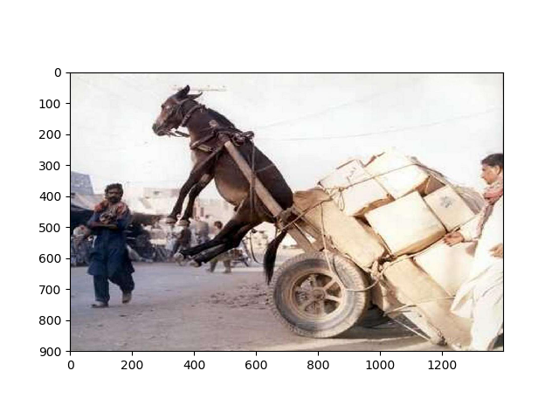
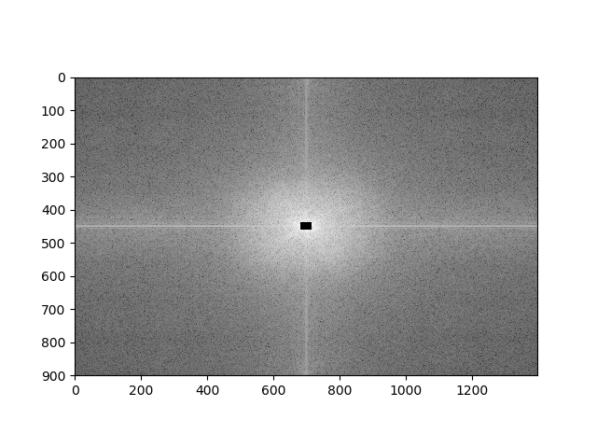
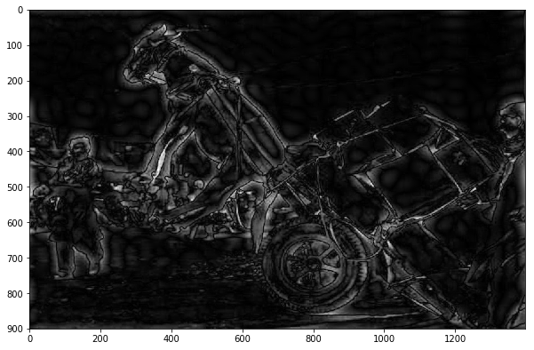
Low-pass and high-pass filtering (here high-pass)
DFT
MASK
IMAGE
Frequency Domain
Masked Freq. Domain
We shift 0 frequency to center
Inverse DFT
https://sbme-tutorials.github.io/2018/cv/notes/3_week3.html#ideal-lpf-example
Notes:
High pass means high frequency are ALLOWED TO PASS

Slide 24
Code break (20 minutes)
Implement:
A low-pass filtering in the previous image
A Gaussian shaped filter that attenuates higher frequency (and that allows low frequency to pass)
A band-pass filter: meaning we allow frequencies within a specific range to pass
Notes:
Slide 7: Practical Demonstration - Frequency Filtering
Title: Practical Demonstration - Frequency Filtering
Example:
Display an image with high-frequency noise, such as a textured background.
Filtering:
Demonstrate how applying a low-pass filter smooths out high-frequency noise, and how a high-pass filter enhances edges and details.
Visual Explanation:
Explain how this approach is similar to reducing noise in signals by focusing on specific frequency ranges.
Visual Suggestion:
Show a single image with high-frequency noise, then display the results of applying both low-pass and high-pass filters.

Slide 25
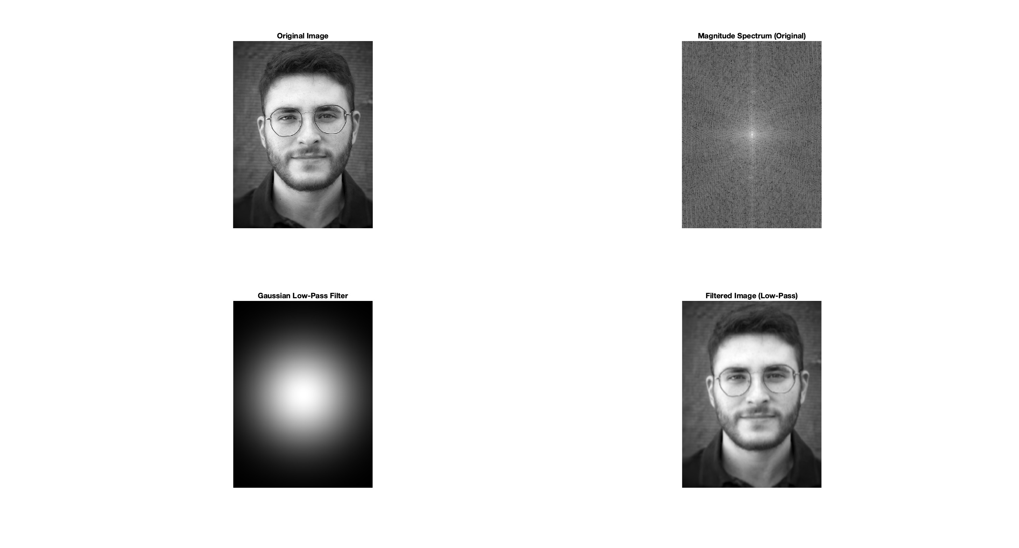
Code break (20 minutes)
Implement:
A Gaussian shaped filter that attenuates higher frequency (and that allows low frequency to pass)
Notes:
Slide 7: Practical Demonstration - Frequency Filtering
Title: Practical Demonstration - Frequency Filtering
Example:
Display an image with high-frequency noise, such as a textured background.
Filtering:
Demonstrate how applying a low-pass filter smooths out high-frequency noise, and how a high-pass filter enhances edges and details.
Visual Explanation:
Explain how this approach is similar to reducing noise in signals by focusing on specific frequency ranges.
Visual Suggestion:
Show a single image with high-frequency noise, then display the results of applying both low-pass and high-pass filters.

Slide 26
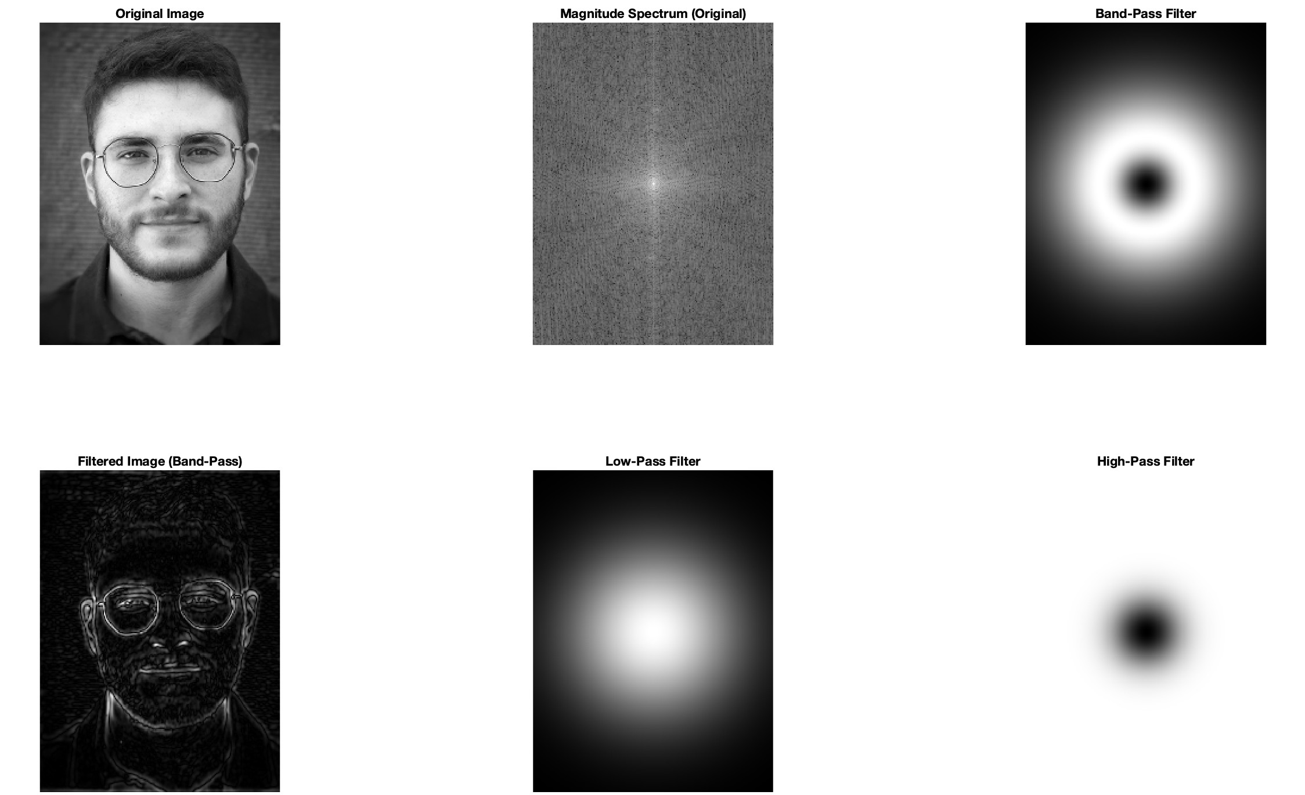
Implement: a band-pass filter: meaning we allow frequencies within a specific range to pass
Notes:
Slide 7: Practical Demonstration - Frequency Filtering
Title: Practical Demonstration - Frequency Filtering
Example:
Display an image with high-frequency noise, such as a textured background.
Filtering:
Demonstrate how applying a low-pass filter smooths out high-frequency noise, and how a high-pass filter enhances edges and details.
Visual Explanation:
Explain how this approach is similar to reducing noise in signals by focusing on specific frequency ranges.
Visual Suggestion:
Show a single image with high-frequency noise, then display the results of applying both low-pass and high-pass filters.

Slide 27
Spatial vs. Frequency domain processing comparison
Aspect | Spatial Domain | Frequency Domain
Operation | Local filtering with kernels (e.g., convolution). | Global filtering of frequency components.
Focus | Works on pixel intensities. | Works on frequency representation of the image.
Applications | Smoothing, sharpening, edge detection. | Noise reduction, smoothing, periodic pattern removal.
Advantages | Easier to implement and interpret. | Allows precise control over global features.
Limitations | Ineffective for global patterns or periodic noise. | Computationally intensive for large images.
Notes:
Slide 7: Practical Demonstration - Frequency Filtering
Title: Practical Demonstration - Frequency Filtering
Example:
Display an image with high-frequency noise, such as a textured background.
Filtering:
Demonstrate how applying a low-pass filter smooths out high-frequency noise, and how a high-pass filter enhances edges and details.
Visual Explanation:
Explain how this approach is similar to reducing noise in signals by focusing on specific frequency ranges.
Visual Suggestion:
Show a single image with high-frequency noise, then display the results of applying both low-pass and high-pass filters.

Slide 28
5. Features extraction

Slide 29
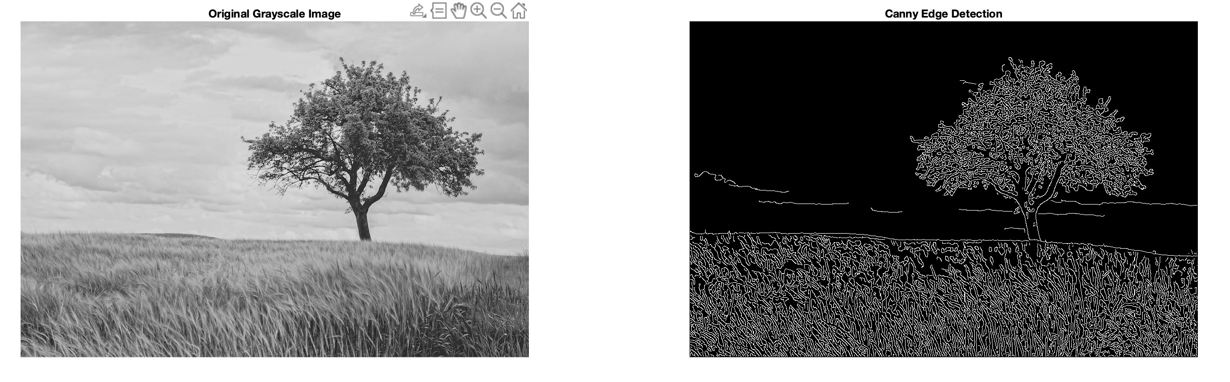
What does it mean
Features extraction: the process of identifying and extracting relevant information (features) from an image to facilitate understanding, analysis, or classification. Features are specific attributes or patterns within the image, such as edges, corners, or textures.
Example: Edge detection as feature detection (Canny – popular filter)
Notes:
Slide 9: Edge Detection as Feature Detection
Title: Edge Detection as Feature Detection
Edge Detection Techniques:
Introduce the Sobel operator and Canny edge detection as methods to detect edges by identifying sharp intensity changes.
Statistical Signal Processing Link:
“Detecting edges is like detecting anomalies in signals—both focus on finding areas of significant change.”
Example Image:
Show an image with edges highlighted, followed by the result of applying an edge detection algorithm.
Visual Suggestion:
Display the same image before and after edge detection, focusing on areas with sharp boundaries.

Slide 30


Segmentation
Jaime’s tutorial
Notes:
Slide 8: Segmentation Basics: Segmentation divides an image into meaningful regions, such as objects or areas of interest, to simplify analysis or extract specific components.
Title: Segmentation Basics
Thresholding:
Explain global thresholding (a single intensity value for all pixels) and adaptive thresholding (local intensity values).
Signal Processing Connection:
“Thresholding segments an image into regions, similar to separating peaks and valleys in time-series data.”
Before-and-After Visuals:
Show an original grayscale image and the same image after thresholding.
Visual Suggestion:
Before-and-after images to illustrate the effect of each thresholding type.

Slide 31
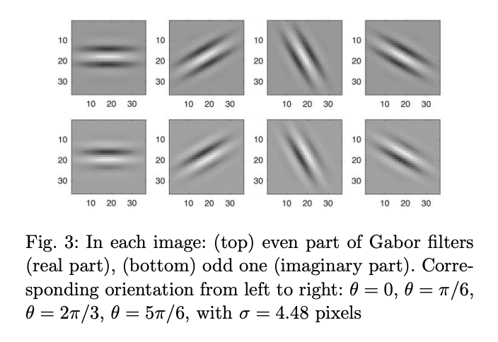
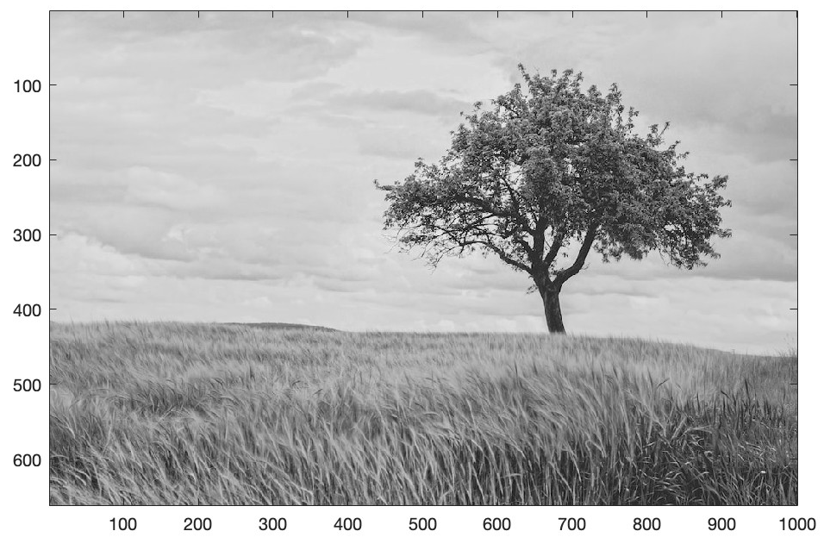
Gabor filters: extracting orientation
Gabor filter code: link
Notes:
Slide 9: Edge Detection as Feature Detection
Title: Edge Detection as Feature Detection
Edge Detection Techniques:
Introduce the Sobel operator and Canny edge detection as methods to detect edges by identifying sharp intensity changes.
Statistical Signal Processing Link:
“Detecting edges is like detecting anomalies in signals—both focus on finding areas of significant change.”
Example Image:
Show an image with edges highlighted, followed by the result of applying an edge detection algorithm.
Visual Suggestion:
Display the same image before and after edge detection, focusing on areas with sharp boundaries.

Slide 32
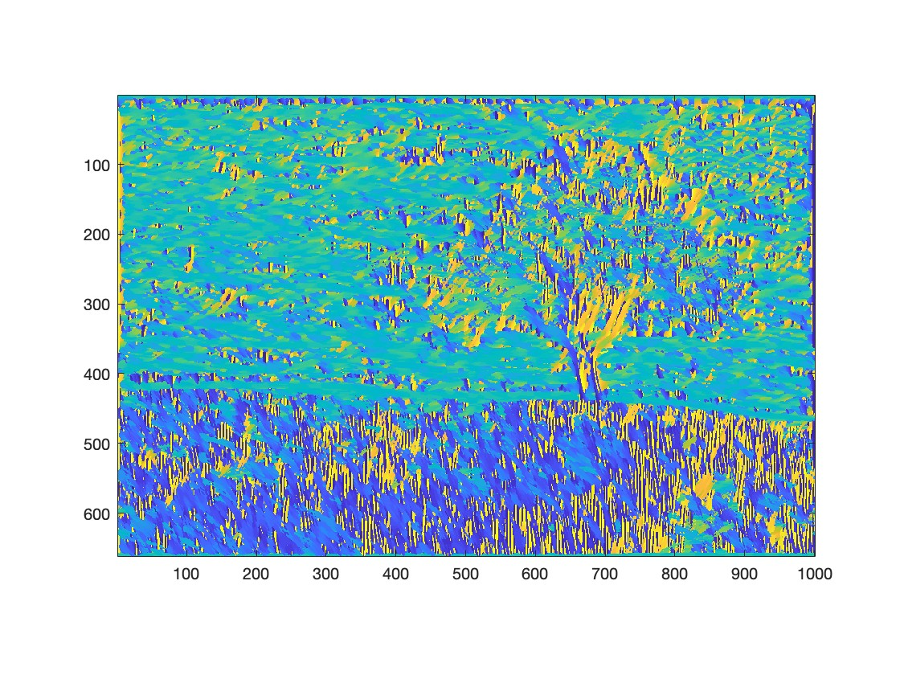
Gabor filters: extracting orientation
Gabor filter code: link
Notes:
Slide 9: Edge Detection as Feature Detection
Title: Edge Detection as Feature Detection
Edge Detection Techniques:
Introduce the Sobel operator and Canny edge detection as methods to detect edges by identifying sharp intensity changes.
Statistical Signal Processing Link:
“Detecting edges is like detecting anomalies in signals—both focus on finding areas of significant change.”
Example Image:
Show an image with edges highlighted, followed by the result of applying an edge detection algorithm.
Visual Suggestion:
Display the same image before and after edge detection, focusing on areas with sharp boundaries.

